Slide 1
Quantile Regression
Mayank Kumar MSc AI Specialization

Slide 2
OVERVIEW
Abstract
Introduction
Problem Statement
Problem Definition
Motivation
Justification
Related Works
Methodology
Material and Data
Models
Condition and Assumption
Formal Complexity/ Simulation Analysis
Computational Experiments
Experiments
Evaluation Metrics
Implementation Details
Results
Discussion
Conclusion
Summary
Future Research
Open Problem
References

Slide 3
Abstract
Research shows feature and target price relation can vary based on target price. Try to investigate how the insight of quantile regression and feature importance change for different model and compare with existing study

Slide 4
Introduction
What is Quantile Regression
Food Interval example
With respect to sale price how it might have different relation with features over target variable – Sales Price

Slide 5
Problem Statement
Creating model to train quantile model on available dataset – “” and investigate the feature importance and literature
Let X be the dataset and …

Slide 6
Motivation
Role of quantile regression in real world application. How powerful are these model ?

Slide 7
Justification
and can we have some comparison with existing literature to backs its supremacy.

Slide 8
Related Work
Housing Paper

Slide 9
Methodology – Material and Data
Data Kaggle and review paper from []

Slide 10
Models
Linear Regression Quantile Model

Slide 11
Condition and Assumption
The data should hold similar pattern and have slightly vary trends with respect to target variable

Slide 12
Formal Complexity
# of quantile * LR complexity

Slide 13
Computational Experiments
Experiments
Setup

Slide 14
Evaluation Metrics
Plot with range and training <90 and < 10
## if create Kaggle solution to show supremancy

Slide 15
Implementation Details
Compute, language and versions
Tensorboard, wandb
Git code

Slide 16
Implementation Details
Feature Engineering – EDA, Handle Missing Value

Slide 17
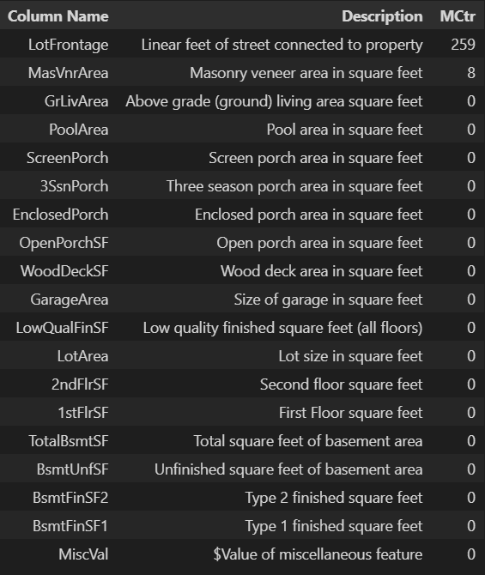
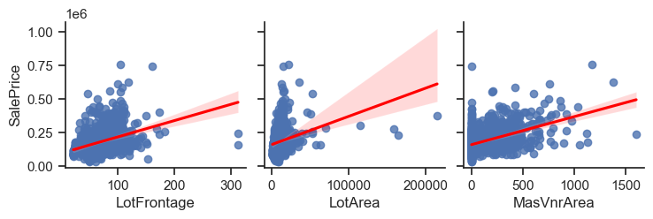
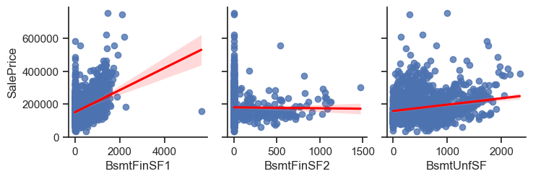

Feature Set - Continuous
Handling Missing Value

Slide 18
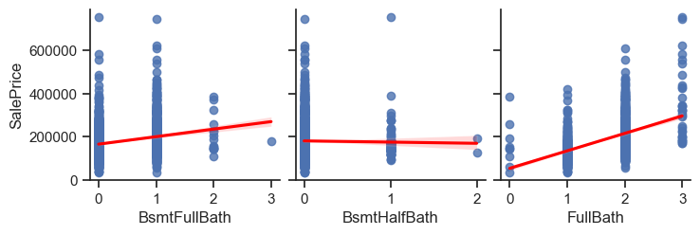
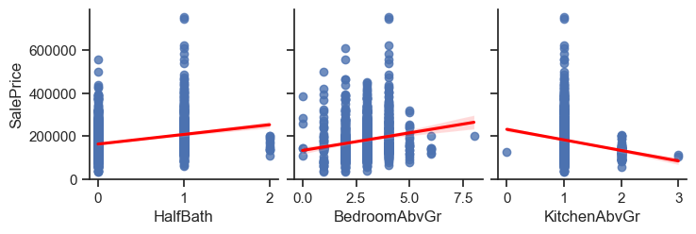
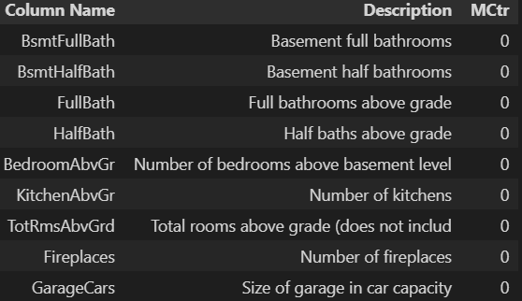
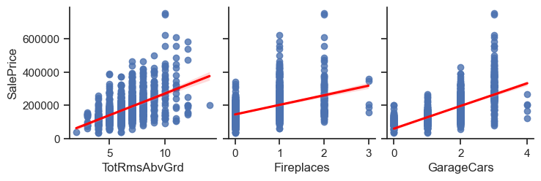
Feature Set - Discrete

Slide 19
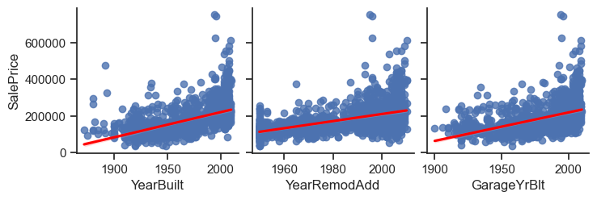
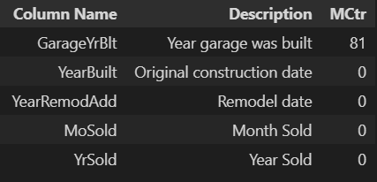
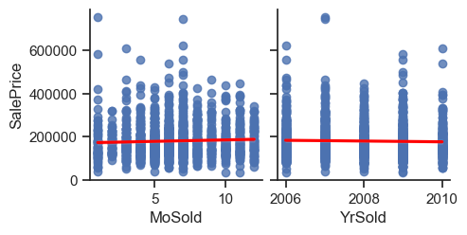
Feature Set - Year
Handling Missing Value

Slide 20
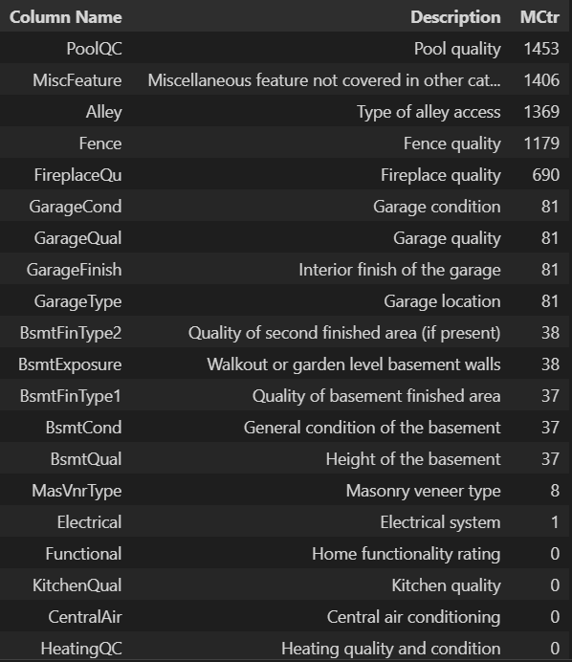
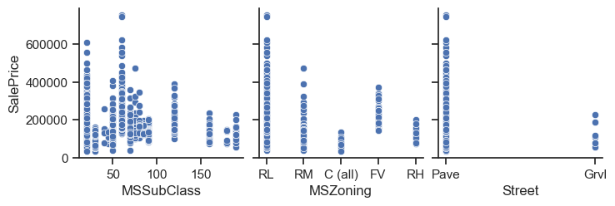
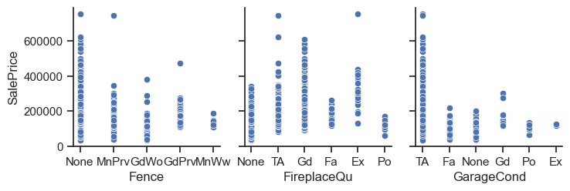
Feature Set - Categorical
Handling Missing Value

Slide 21
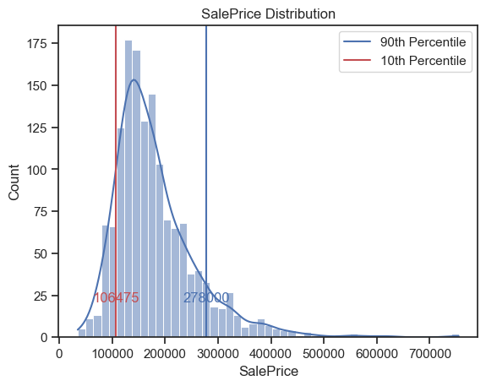
Target – SalePrice Distribution

Slide 22
Data split

Slide 23
Feature Selection
Filter Methods
Basic methods - remove constant and quasi-constant features.
Constant features are those that show the same value, just one value, for all the observations of the dataset
Quasi-constant features are those that show the same value for the great majority of the observations of the dataset.
Univariate methods
Correlation Matrix with Heatmap
Correlation is a measure of the linear relationship of 2 or more variables.
Variables should be correlated with the target but uncorrelated among themselves
81
373
261
261

Slide 24
Model Train
Loss graph

Slide 25
Model Test
Self % count within range and actual

Slide 26
Results
P value for some feature from different quantile model

Slide 27
Discussion
LigtgbmRessor possible

Slide 28
Conclusion
Study establish factual link with the behaviour of feature characteristic and suggest models which are trained on quantile

Slide 29
Future Research
Can try quantile using more advanced models such as lightgbm regressor

Slide 30
Open Problem

Slide 31
References

Slide 32
THANK YOU

